Slide 1


Installation of the Surveillance Cameras in Katara Park
BY
Shefali Mohapatro
1606022
Under the supervision of
Dr.MTU Haider
Date:6th June 2020
Department of Computer Science and Engineering
National Institute od Technology Patna

Slide 2
Outline
Introduction
OSI Model…………………………………………………………………….3
Layout and Implementation
Virtual Layout……………………………………………………………….17
Required Parts in the project……………………………………………….7
The Office IT Rack………………………………………………………......5
The process of Video Captured…………………………………………..25
Conclusion………………………………………………….31
References………………………………………………….32
2

Slide 3
OSI Model
Introduction
Application Layer
Presentation Layer
Session Layer
Physical Layer
Transport Layer
Network Layer
Data Link Layer
Open Systems Interconnection
model

Slide 4
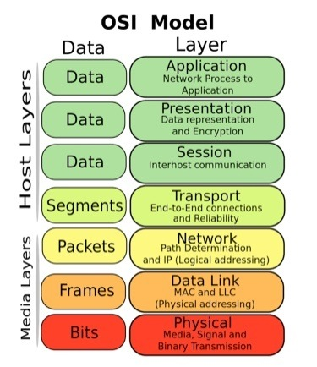
Application Layer: Human computer interaction layer, where applications can access the network services.
Presentation Layer: Ensures that data is in a usable format and is where data encryption occurs.
Session Layer: Maintain connections and is responsible for controlling ports and sessions
Transport Layer: Transmits data using transmission protocol including TCP and UDP
Network Layer: Decides which physical path the data will take.
Data Link Layer: Defines the format of data on the network.
Physical Layer: Transmits raw bit streams over the physical medium
Figure 1. OSI Model [5]

Slide 5
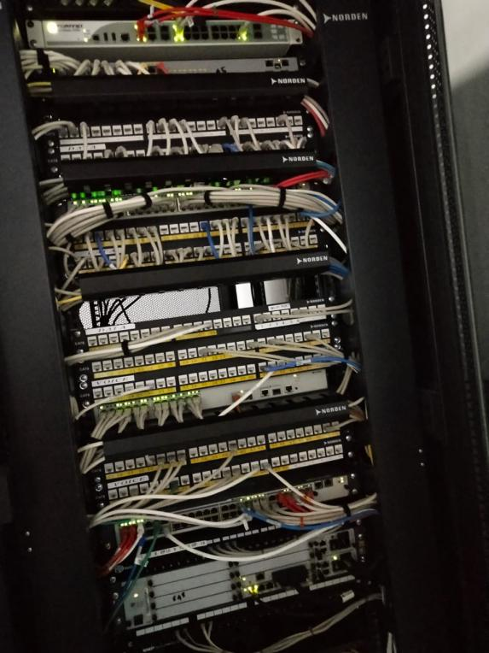
The office IT rack
The basic setup in a company

Slide 6
This is the firewall patch panel : For the security purpose.
Switch: Is for the correct data transmission.
Data / Voice plug patch panel: Data plug is for internet connections and voice plug is for telephony connections
Camera connection: That slot is connected and can be used to check the cameras IP address and do the necessary operations on it.
Servers: There are in total of 3 servers , server 3(DHCP, DNS) is the main server backed up by server 1 and 2.
Memory storage: Nas is of 8TB, this is used to store the files, documents. Managed by the admins.
UPS: This is the backup power. also has extra batteries which helps it to perform well, or if it drains out energy.

Slide 7
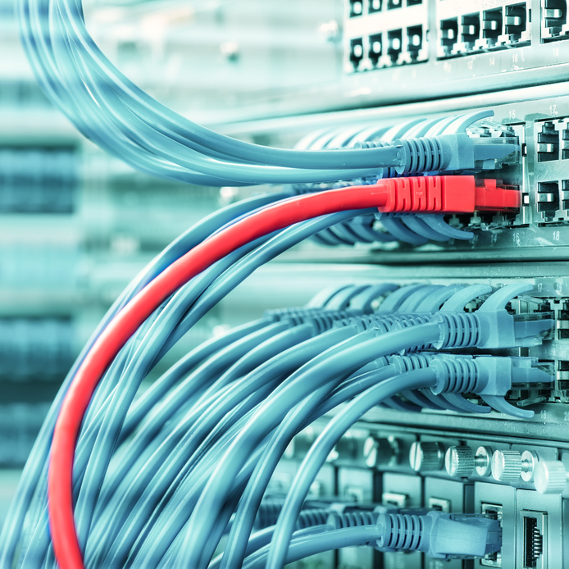
The required parts in the project
Cables, switches, storage, etc.

Slide 8
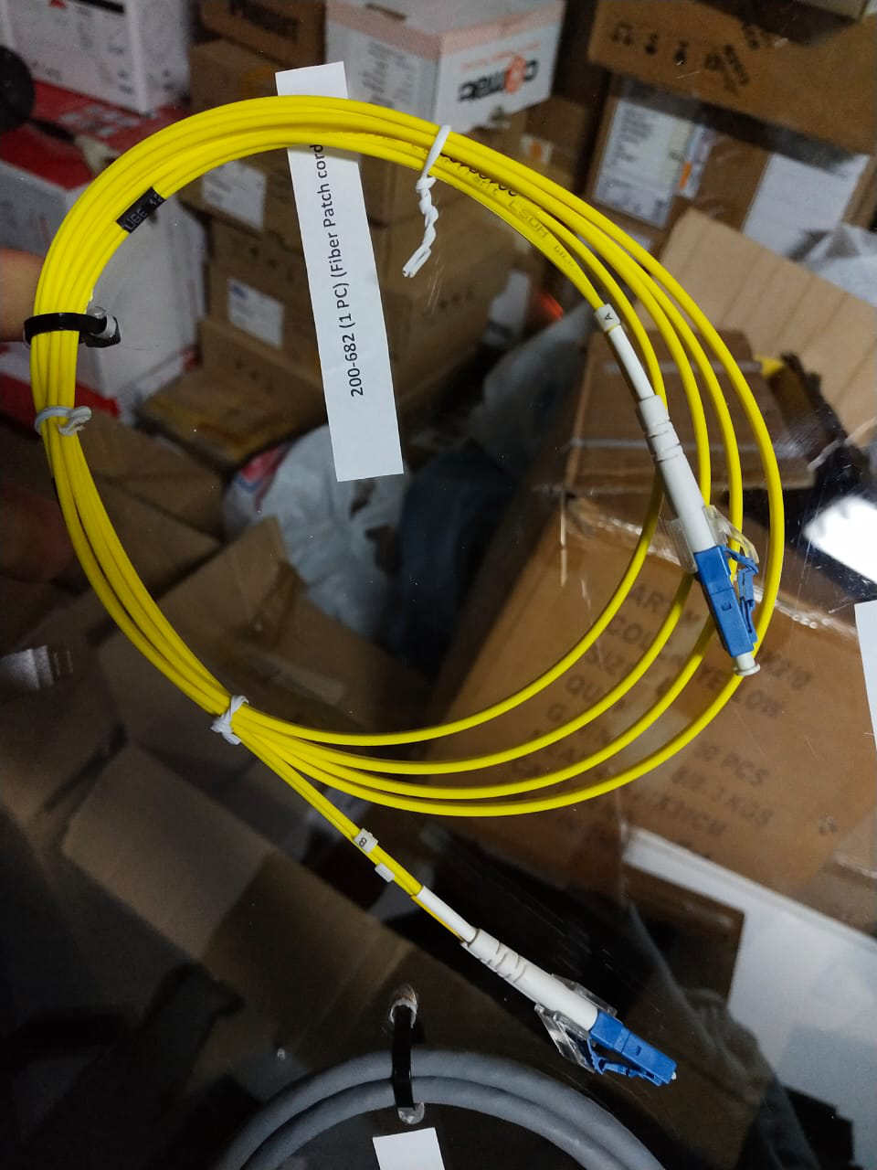
FIBER CABLE
The fiber cable we use are the single-mode fibers as the distances of the switches are more than 500m.
It has 2 cores as fiber cables require RX,TX for the data transmission.
The patch panels are for north hill and south hill.
Half of the panel will be empty as the data transmission requires only 2 cores, the other 2 cores will be kept as a backup.
And then this cables are connected to a switch with the help of SFP module.

Slide 9
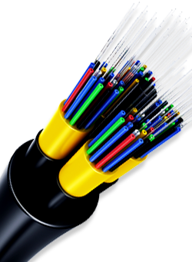
BACKBONE
We use 4 core backbone.
Backbone has a collection of various fiber cores.
This are spliced and connected inside the patch panel with the help of pigtails which is a connector.
Outside the rack the connections are made to the switch using a fiber cable.

Slide 10
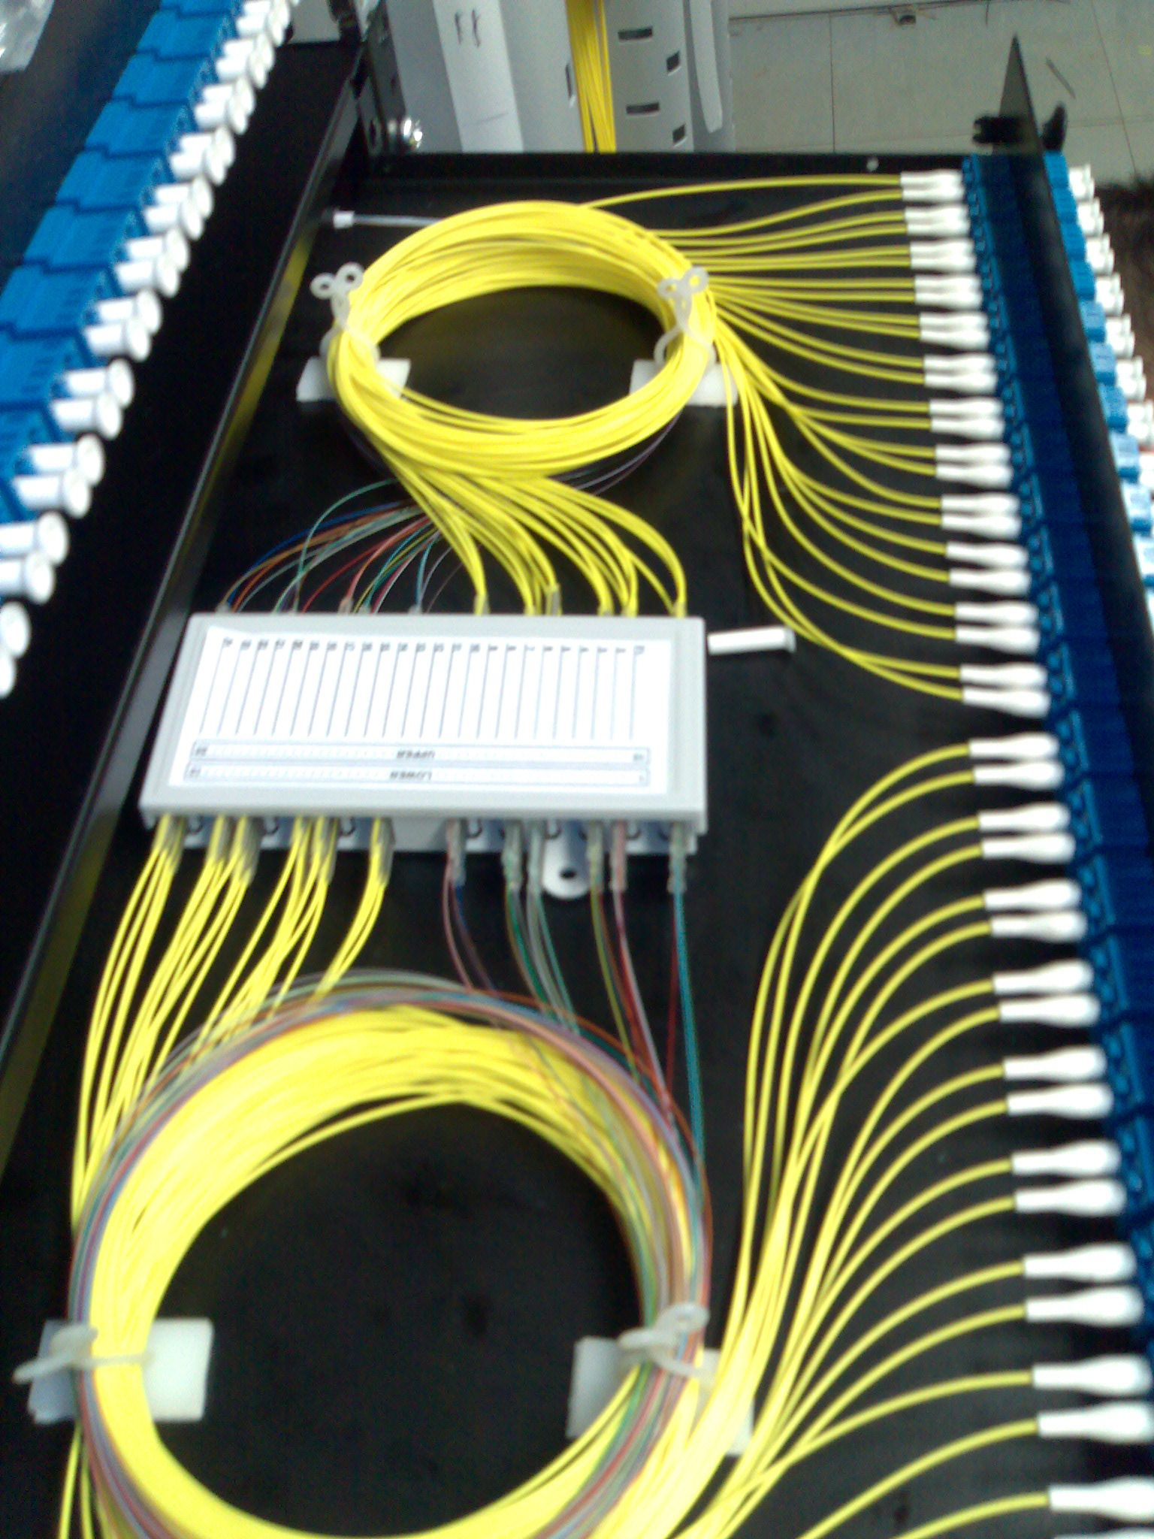
SPLICING
This is how spliced backbone looks inside the patch panel.
The splicing is done by experts as the core are very sensitive and prone to break easily.
In our there are 2 patch panels, for north pole and south pole, each with 12 pairs connected to the switch and the other 12 for backup.
So total 24 are connected and the other 24 are kept for backup.

Slide 11
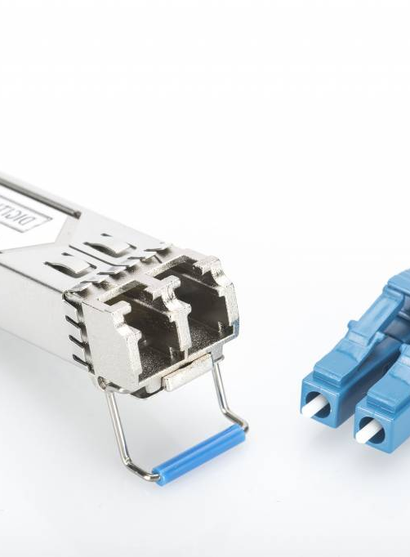
SFP MODULE
With the help of SFP Module we are able to connect the fiber cables to the switch.
As fiber cable requires 2 cores for a complete data flow (TX,RX), the SFP has 2 ports.

Slide 12
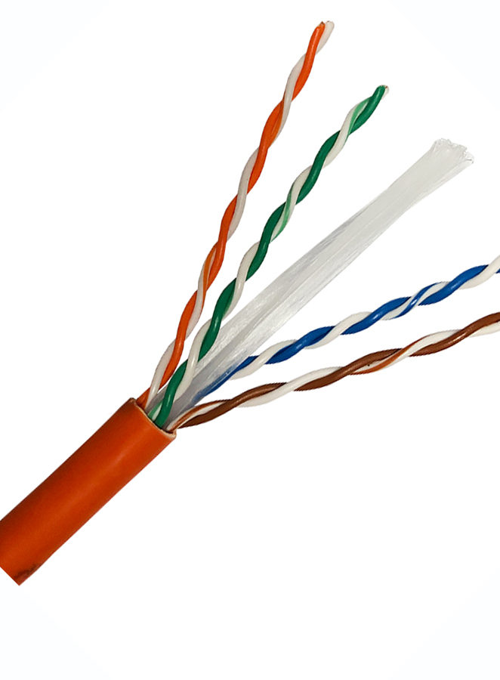
CAT6 coaxial cable
This is used for connecting the cameras to the switches that are inside the manhole.
Even in the IT rack to connect various switches with the patch panels.

Slide 13
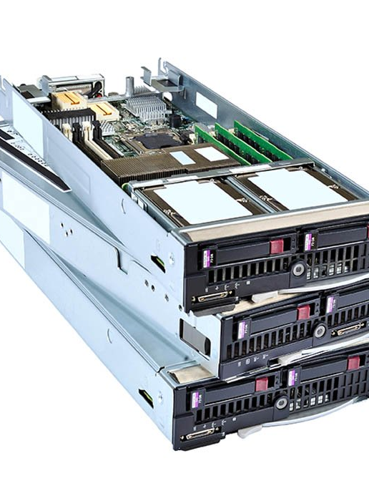
BLADE SERVER
A blade server is a stripped-down server computer with a modular design optimized to minimize the use of physical space and energy.
In this each server has 2 connections 1st for accessing the camera image and 2nd for accessing the storage.
Each server is divided almost equally for handling the devices.

Slide 14
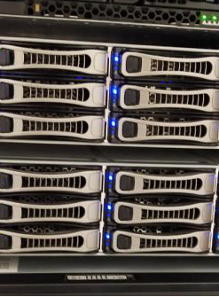
STORAGE
This the storage, which is not in our scope.
This is connected from the server with a cat6 cable.

Slide 15
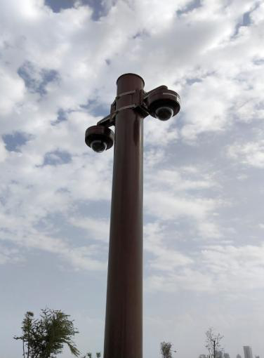
Camera
These are the cameras that are placed in the park
The connection was being made for these surveillance cameras which are placed on the North and South hill.

Slide 16
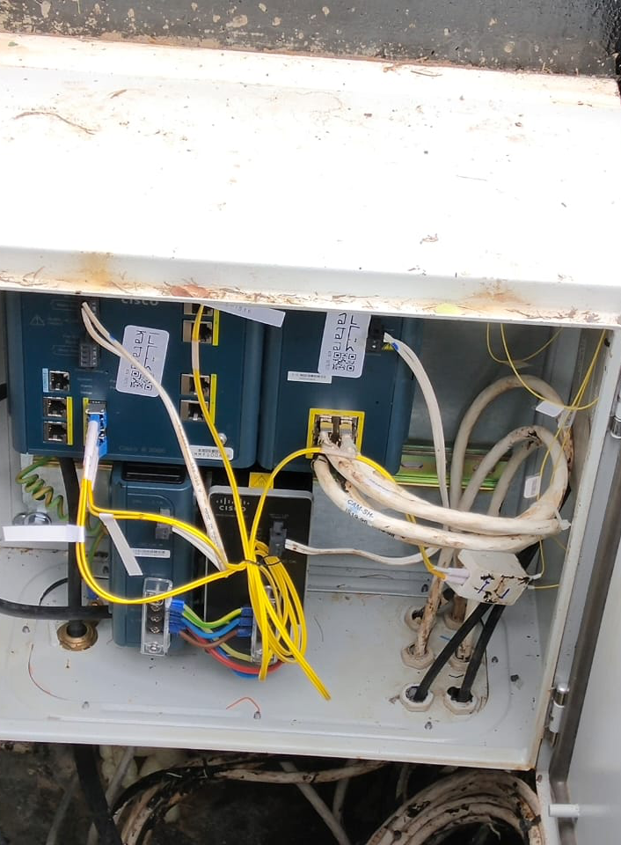
SWITCH INSIDE THE MANHOLE
The switches are placed under the manhole are the industrial switches.
Each switch is connected to 5 - 6 surveillance cameras
The switch is connected to other switches in a ring fashioned topology.
The Top left is the main switch where the backbones are spliced and connected.
The Top right is the expansion module which has copper port where it used to connect with the cameras. The white cables are used.
The Bottom left is for power supply to the switch
The Bottom right is for power supply to the expansion module

Slide 17
The Virtual Layout
Layout and Implementation
Productively connecting the connections

Slide 18
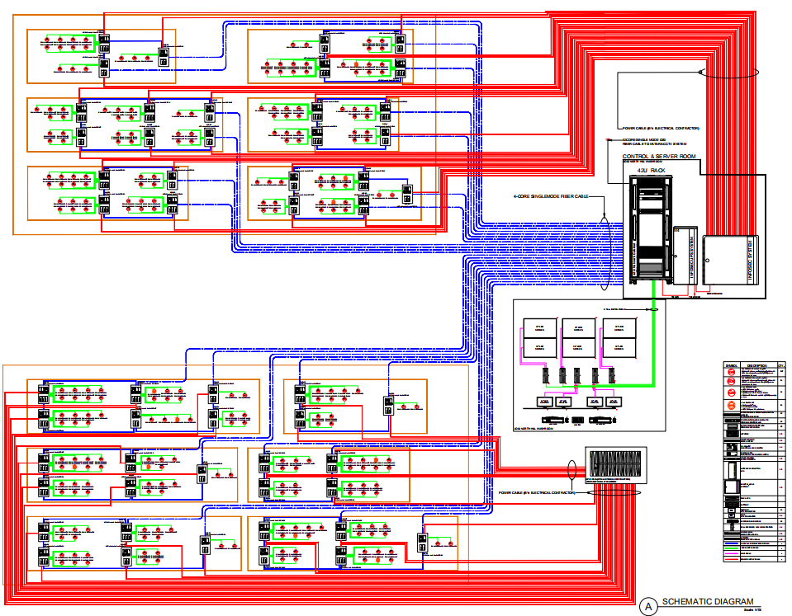
18

Slide 19
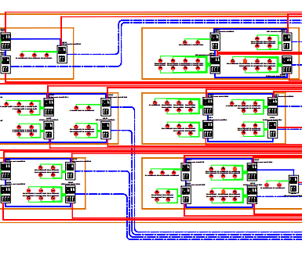
SOUTH HILL
This is the South Hill
This how the connections are made
The surveillance cameras and connected and installed in this fashion.
The switches are connected in ring fashion
Therefore there are 6 such rings in the South Hill

Slide 20
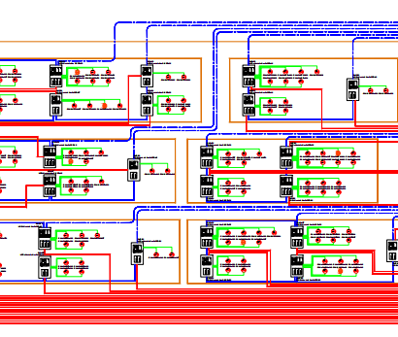
NORTH HILL
This is the North Hill
This is how the connections are made
The surveillance cameras and connected and installed in this fashion.
The switches are connected in ring fashion
Therefore there are 6 such rings in the North Hill

Slide 21
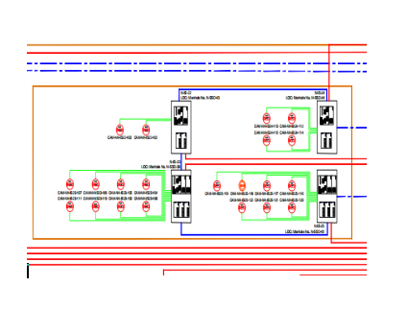
SWITCHES INSIDE THE MANHOLE
This is a part of the connection.
The switches are connected in a ring fashioned topology.
Each switch has 2 or more surveillance cameras connected to it.
As the switches are connected in ring fashion, there are two backbone each of 4 core for each ring connected to the IT rack

Slide 22
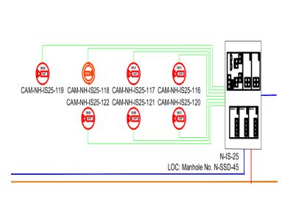
CAMERA CONNECTION WITH THE SWITCH
This is one of the switches, in which there are 7 surveillance cameras connected.

Slide 23
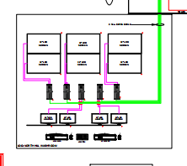
SURVEILLANCE ROOM
This is the place where we are able to see the footage captured by the surveillance cameras.
It is connected to the IT racks storage where the clips/footage's are stored

Slide 24
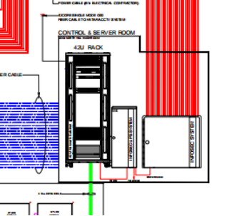
SERVER ROOM
This is the IT rack where the all the connections are managed and controlled

Slide 25
The Process of Video Captured
Camera
Industrial Switch
Switch1
Switch2
Switch3
Blade Server
In the server room in the south hill
Storage

Slide 26
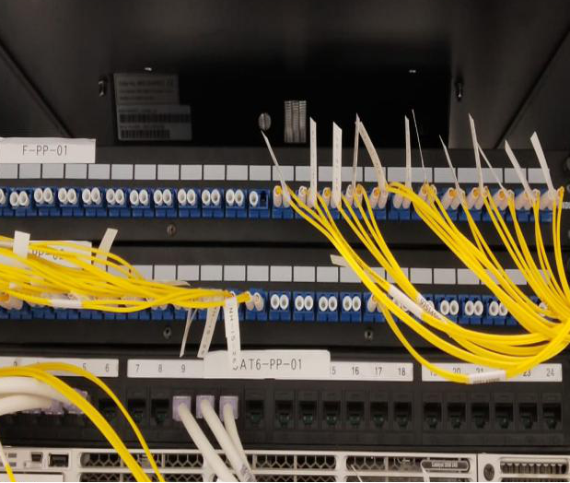
The Fiber Cable Patch Panel
This is how the backbone of 4 core (2 cores are used
for transmission and receiving and other 2 are spare)
is being spliced and connected through pigtail.
In this we can see half are empty and half are
filled, as only 2 cores are required for data flow in fiber
cables and we used are 4 core cable.
Due to which only half are connected and rest
are spare, if some issues occur to the current
cores the spare ones can be used.
The first patch panel is for the North hill.
The second patch panel is for the South hill.

Slide 27
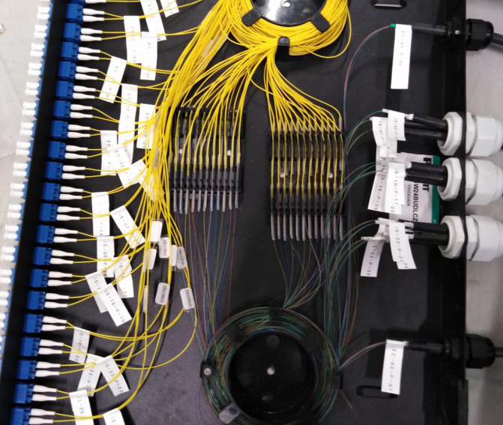
Splicing done inside the Fiber Cable Patch Panel
This is what is inside the patch panel, where the backbones are spliced with individual fiber cables and connected to the pigtails.

Slide 28
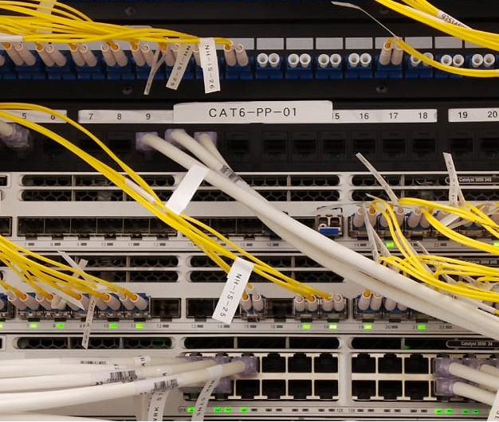
Switch 1 & 2
So the 2 cores that are being used are the connected to the switch 1 and 2.
The fiber cable we use are single-mode fiber as the distances of the switches are more than 500m.
The first switch1 is of the North hill
The second switch 2 is of the South hill

Slide 29
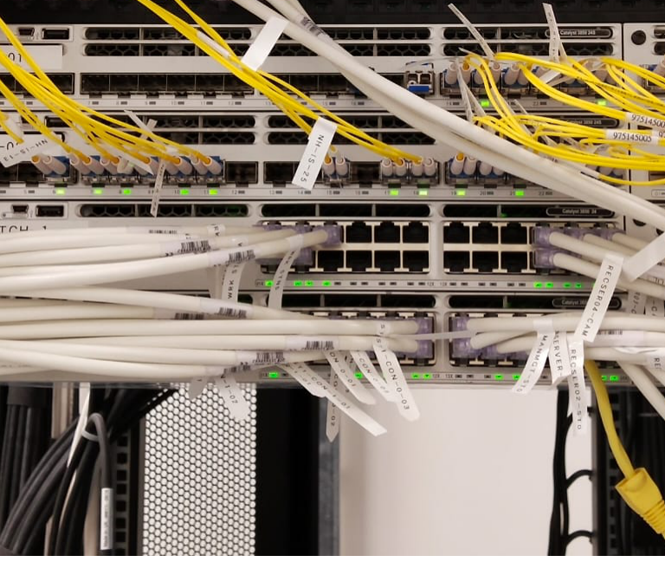
SWITCH 3
After the switch1 and switch2, the switch3 is for server and storage connection which is from the back of the IT rack.
As this switch has copper ports, and needs to access the camera footage its needs to be connected with switch1 and switch2 with fiber cables, using the SFP module.

Slide 30

During the course of my internship at Informatica Qatar, I got to know a lot of domain specific knowledge related to Networking. During the internship bootcamp training which lasted for fourteen days, I got to learn a lot about the company and various technologies they use in their products. Sessions were conducted on the basic knowledge on networking, without having a strong base its quite difficult to proceed with any work. I got to contribute to the topology of the system, which aimed to reduce the overall cost, more efficient and durable. Choosing the cables, configuring the devices manually, giving them an unique id.
CONCLUSION

Slide 31

[1] LBS Networking Essentials.ppt [2] https://www.geekforgeeks.com/ [3] https://www.youtube.com/ [4] https://www.cisco.com/ [5] Networking Layout [6] http://web.opalsoft.net/qos/ [7] http://computernetworkingtopics.weebly.com/ [8] https://slideplayer.com/slide/5028490/ [9]https://medium.com/software-engineering-roundup/ [10] https://networkencyclopedia.com/ [11] https://OmniSecu.com/

Slide 32
THANK YOU!!
Date:10th May

